Slide 1




Mentorness internship Task-3 Project-You-Tube Songs Analysis Pooja Jadhav(MIP-da-03)

Slide 2
agenda
Introduction
Problem statement
Data description
Project objectives
Dashboard & some KPI’s
Conclusion and recommendation

Slide 3

Introduction to YouTube Songs Analysis

Slide 4
In this YouTube song data analysis project, we'll delve into various aspects of popular songs on YouTube. We'll uncover trends in viewership, analyze user engagement patterns, and extract hidden insights from the data. Through this exploration, we aim to gain a deeper understanding of the dynamics behind the most popular music videos on YouTube.
The objective of this analysis is to delve deep into the wealth of YouTube song data using the powerful analytics capabilities of Power BI. By leveraging this tool, we aim to extract actionable insights that can drive informed decision-making and strategy formulation in the dynamic landscape of music content creation and promotion.

Slide 5

Problem Statement
This internship project aims to conduct a comprehensive analysis of YouTube songs data using Power BI. The dataset contains key attributes such as video ID, channel title, title, description, tags, published date, view count, like count, favorite count, comment count, video duration, video definition, and caption details. The goal is to utilize Power BI to create insightful visualizations and reports that provide a deeper understanding of YouTube songs' performance, popularity, and user engagement. The analysis aims to uncover trends, preferences, and patterns in the data to aid content creators and stakeholders in optimizing their YouTube song content.

Slide 6
Dataset Description
1. video_id: Unique identifier for each YouTube video.
2. channelTitle: Title of the YouTube channel publishing the song.
3. title: Title of the YouTube song video.
4. description: Description provided for the YouTube song video.
5. tags: Tags associated with the YouTube song video.
6. publishedAt: Date and time when the YouTube song video was published.
7. viewCount: Number of views received by the YouTube song video.
8. likeCount: Number of likes received by the YouTube song video.
9. favoriteCount: Number of times the YouTube song video has been marked as a favorite.
10. commentCount: Number of comments posted on the YouTube song video.
11. duration: Duration of the YouTube song video.
12. definition: Video definition or quality (e.g., HD, SD).
13. caption: Availability of captions for the YouTube song video.

Slide 7

Project Objectives
1. Data Cleaning and Preparation
Data Loading:
Import the YouTube songs dataset into Power BI using appropriate data connectors.
Verify that the data is loaded correctly and review the structure of the dataset.
Standardizing Text Data:
Standardize text data such as tags, descriptions, and titles to ensure consistency.
Perform tasks like removing special characters, converting text to lowercase.
Data Type Conversion:
Ensure that each column has the correct data type.
Convert columns to appropriate data types (e.g., date/time, numerical, categorical) based on their content and intended use.

Slide 8



2. Exploratory Data Analysis (EDA)
Data Patterns
Identify recurring patterns and correlations within the dataset through comprehensive trend analysis.
Emerging Trends
Spotlight emerging trends and shifts in viewer engagement and music consumption behavior.
Statistical Insights
Derive statistical insights to uncover hidden trends and impactful data variations over time.

Slide 9

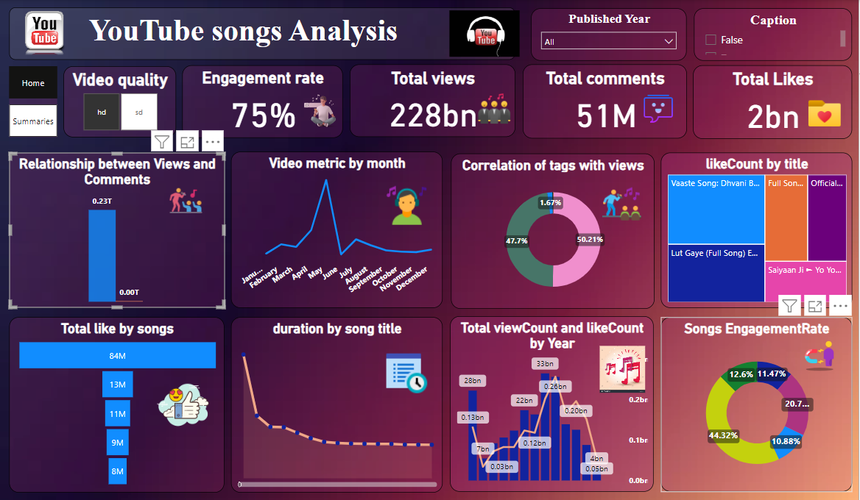
Home Dashboard

Slide 10
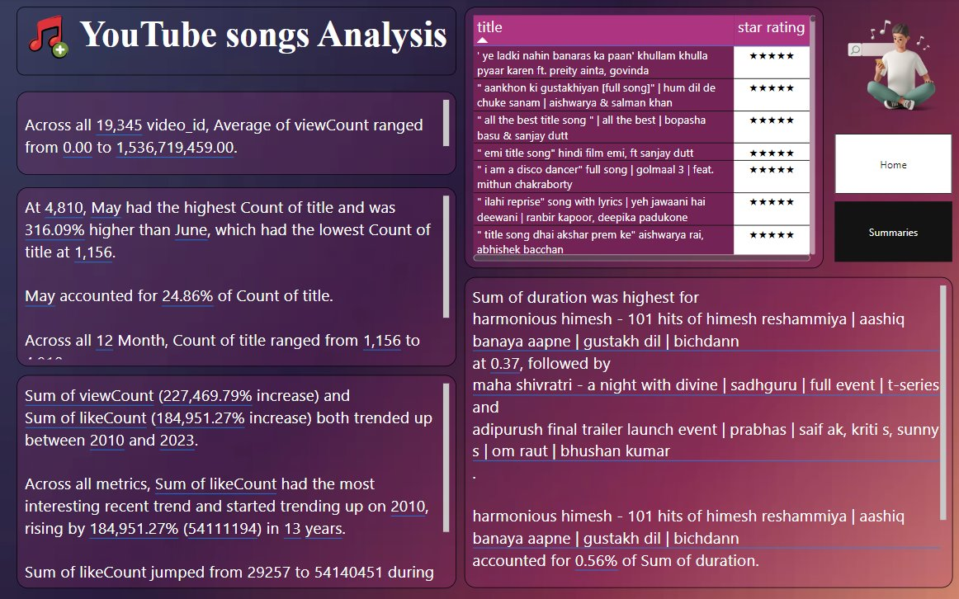
Summary Dashboard

Slide 11

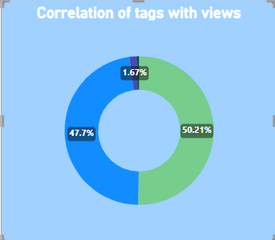

Kpi's
Correlation between Tags and views
Here we see that ﻿['कबीर के दोहे', 'सन्त कबीर', 'कबीरदास', 'poet', 'popular dohe', 'Popular Dohe', 'Kabir', 'kabir dohe', 'kabir dohe song', 'jubin nautiyal new song', 'jubin kabir dohe', 'Kabir dohe', 'kabir ke dohe', 'dohe of kabir', 'famous kabir dohe', 'best kabir ke dohe', 'kabir dohas', 'Famous Kabir Ke Dohe', 'tseries', 'jubin nautiyal songs', 'jubin nautiyal', '(कबीर दोहे)'] have high i.e. 50.21% of Sum of viewCount.
This Photo by Unknown author is licensed under CC BY-SA-NC.

Slide 12
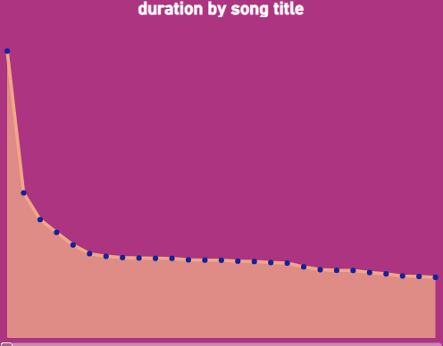
Kpi's
Duration of songs :
In this Average of duration was highest for harmonious himesh - 101 hits of himesh reshammiya | aashiq banaya aapne | gustakh dil | bichdann at 0.37, followed by maha shivratri - a night with divine | sadhguru | full event | t-series and radhe shyam pre release event live | prabhas | pooja hegde | bhushan kumar | 11th march 2022.
﻿Here we see that ﻿Across all 19,217 title, Average of duration ranged from 0 to 0.37.﻿﻿ ﻿﻿
This Photo by Unknown author is licensed under CC BY-SA-NC.

Slide 13
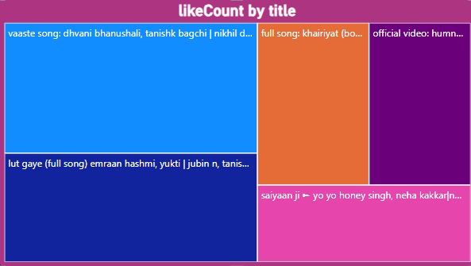
Kpi's
Like count of title :
﻿In this at 12840215, vaaste song: dhvani bhanushali, tanishk bagchi | nikhil d | bhushan kumar | radhika rao, vinay sapru had the highest Sum of likeCount and was higher than saiyaan ji ► yo yo honey singh, neha kakkar|nushrratt bharuccha| lil g, hommie d| mihir g|bhushan k, which had the lowest Sum of likeCount at 6387196.
﻿﻿Across all 5 title, Sum of likeCount ranged from 6387196 to 12840215.
This Photo by Unknown author is licensed under CC BY-SA-NC.

Slide 14

CONCLUSION
In conclusion,
The analysis of YouTube songs data using Power BI has provided valuable insights into the performance, popularity, and user engagement of videos.
By leveraging data-driven decision-making, content creators and stakeholders can optimize their strategies to enhance video performance and audience engagement.
The project highlights the importance of continuous analysis, adaptation, and strategic planning in the dynamic landscape of online content creation.
Through interactive visualizations and in-depth analysis, this internship project contributes meaningful recommendations for improving YouTube song video performance and maximizing user engagement in a competitive digital environment.

Slide 15
RECOMMENDATIONS
1.Content Strategy Optimization:
Utilize insights on popular tags to enhance visibility and engagement.
Experiment with video duration and quality based on user preferences.
2.Engagement Enhancement:
Encourage viewer interaction through calls-to-action for likes and comments.
Respond actively to comments to foster a sense of community and engagement.
3.Temporal Strategy:
Schedule uploads during peak times to maximize visibility and engagement.
Analyze temporal trends to align content release with audience behavior.

Slide 16
Thank you

